Slide 1
DIALOGUE NATIONAL SUR LES EAUX SOUTERRAINES - NATIONAL DIALOGUE ON GROUNDWATER
January 15, 2020 (1 – 2pm (ET))

Slide 2
FIRST CALL - OVERVIEW
Participants Role call (5-10 min)
Opening remarks (5 min) – Daniel Lebel
Groundwater Geoscience Program (5 min) - Yves Michaud
Archetypal Aquifer Project (5 min) - Hazen Russell
Mapping the Principal Bedrock Aquifers of Canada (5 min) - Alfonso Rivera
Groundwater Information Network (5 min) - Boyan Brodaric
Logistics for future meetings (5 min)
Content
Format
Comments / suggestions (15 min)

Slide 3
Groundwater Geoscience Program Phase V 2019-2024
Program’s goal
To better understand groundwater distribution, quantity, flow dynamics and possible impacts on Canada’s sustainable developments
Themes and Project’s titles
Groundwater inventories - Archetypical Aquifers
Cumulative effects - Fox Creek aquifer system
Methods for assessing groundwater - Water resources characterization and modeling
Data modeling and dissemination - Groundwater information network
Outputs
Produce geoscience knowledge tools and information
Ultimate Outcome
Better management of Groundwater resources

Slide 4
Archetypal Aquifer Project: Introduction
Groundwater Geoscience Program
National Dialogue on Groundwater
Hazen A.J. Russell
2020-01-15

Slide 5
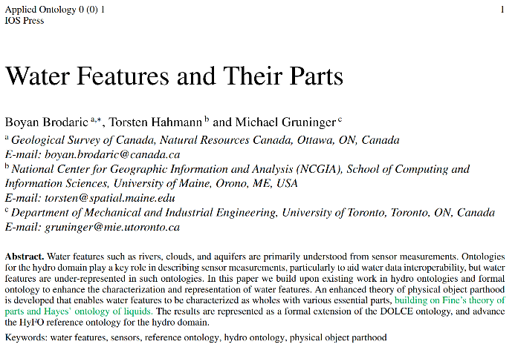
AA Plan: Five Step
Classification development
Data consolidation
Case studies
Archetypal aquifer summaries
National synthesis maps

Slide 6
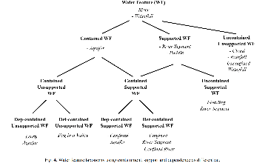
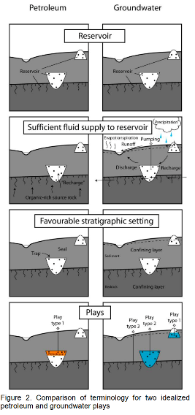
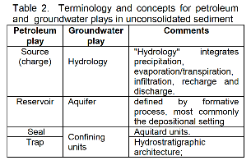
Classification Development
Move away from landform – sediment approach
Consider three components – charge, reservoir, and confinement
Step one –literature review / consultation

Slide 7
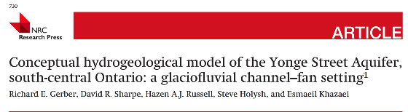
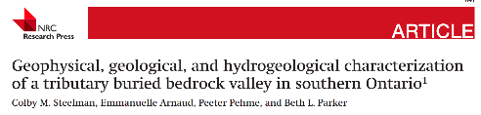
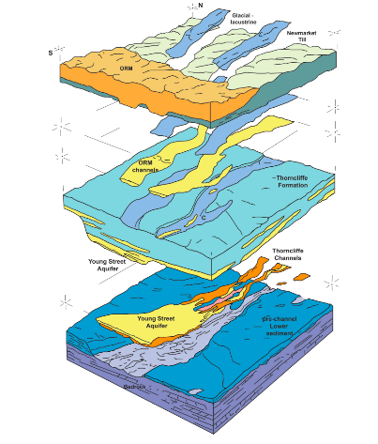
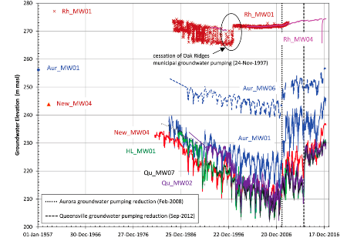
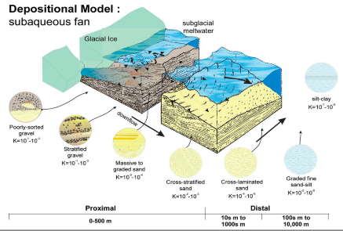
Case Studies
Architecture /
Confining layers
Hydraulic Properties / Response
Aquifer Facies / Physical Properties

Slide 8
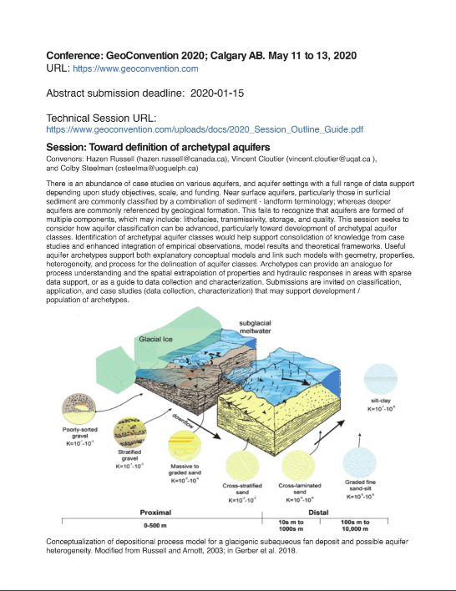
Calgary 2020
Outreach and community engagement
GeoConvention 2020
Toward Definition of Archetypal Aquifers

Slide 9
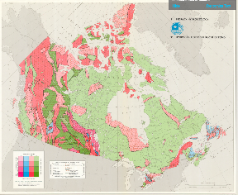
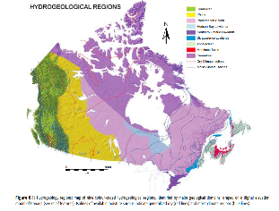
National Maps
Synopsis maps at national scale are required
Bedrock and surficial aquifers
bedrock version ##
Rivera to present on emerging plan
1978
2014
2020

Slide 10
Summary / Impact
Science based classification
National application
Information consolidation
Framework for national synthesis products

Slide 11

Mapping the Principal Bedrock Aquifers of Canada Alfonso Rivera Geological Survey of Canada
Quebec City, January 15, 2020

Slide 12
Ciencia, política y gestión del agua subterránea en Canadá
Mapping the Principal Aquifers of Canada
Introduction – objective
Background knowledge and previous works
Approach to the classification and delineation of bedrock aquifers
Summary and next steps

Slide 13
Introduction – why this map?
Persistent and emerging issues at the national scale can only be covered with an integrated Pan-Canadian map of aquifers, such as:
Water availability and use (towards sustainability and protection of GW).
Water-Energy Nexus (oil and gas, CBM, shale gas).
SW/GW interactions and land use.
Transboundary aquifers and GW (interprovincial and international).
GW monitoring and climate variability and change to cover the complete mass of Canada.

Slide 14
Objective
CCA’s (2009) First goal for GW sustainability:
“Develop a common framework for aquifer classification, characterisation and groundwater flow systems to allow integration of data from local studies into broader regional and national assessments.”

Slide 15
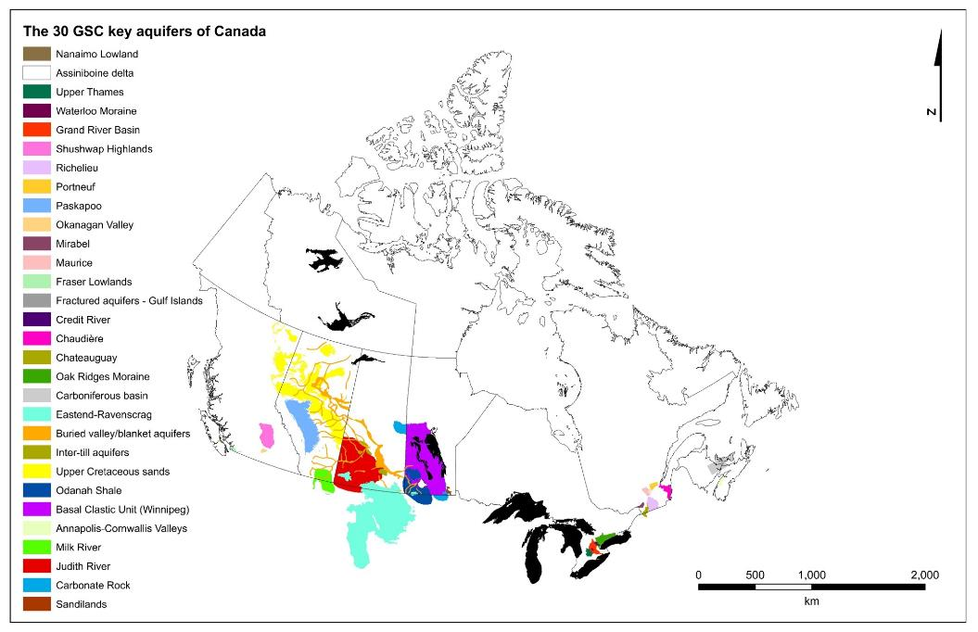
Background knowledge and previous works
GSC 30 Regional-scale Aquifers of Canada
The assessment of these aquifers covers less than 6 % of Canada’s landmass, but they can be used to extrapolate to the national scale.

Slide 16
Background knowledge and previous works
Build upon current knowledge and available data from the GSC, the Provinces and others
The hydrogeological regions of Canada (Sharpe et al., 2014)
The GSC 30 archetypical Canadian aquifers (Rivera, 2018)
Transboundary Aquifers (Rivera, 2015)
Groundwater use in Canada (Rivera, ed., 2014)
Observation wells in Canada (Maathuis, 2004)
The water table across Canada (Rivera et al., 2018)
Evapotranspiration in Canada (Wang et al., 2012)
Groundwater recharge in Canada (Wang et al., 2011)
GW storage changes 2002-2014 using GRACE (Huang et al., 2014)
Regional aquifers mapped by the Provinces (many)

Slide 17

Approach to the classification and delineation of bedrock aquifers
Rock type | Formation type | Origin | Lithology | Aquifer flow/ storage
UNCONSOLIDATED | (See Russell)
CONSOLIDATED | Sedimentary | Clastic | Sandstone dominated | Intergranular, Fractured, Both
 |  | Carbonate | Limestone dominated
 | Volcanic terrain | Volcanic | Lava, tuffs, ash | Fractured
 | Basement | Igneous Granite | Crystalline
 | Shale |  | Shale dominated | Considered as aquitards
 | Shale interbedded |  | Some clastic or carbonate interbeds | Considered as aquifers
 | Other |  | Interbedded lithologies | Not considered principal aquifers, but may contribute to GWFS
(Rivera et al., 2018)

Slide 18
Bedrock aquifers delineation criteria, based on geological conditions
Scales of delineation : national 1:5M and regional 1:1M.
Bedrock aquifers are delineated in 2D horizontal with a 1000-m (x,y) resolution.
Map both confined and unconfined bedrock aquifers.
Two types of basic boundaries: no-ﬂow boundaries and constant-head boundaries.
The thickness of bedrock aquifers is from a minimum of 10 m to a maximum of 300 m.
A fully digital, 2D-horizontal delineation.

Slide 19
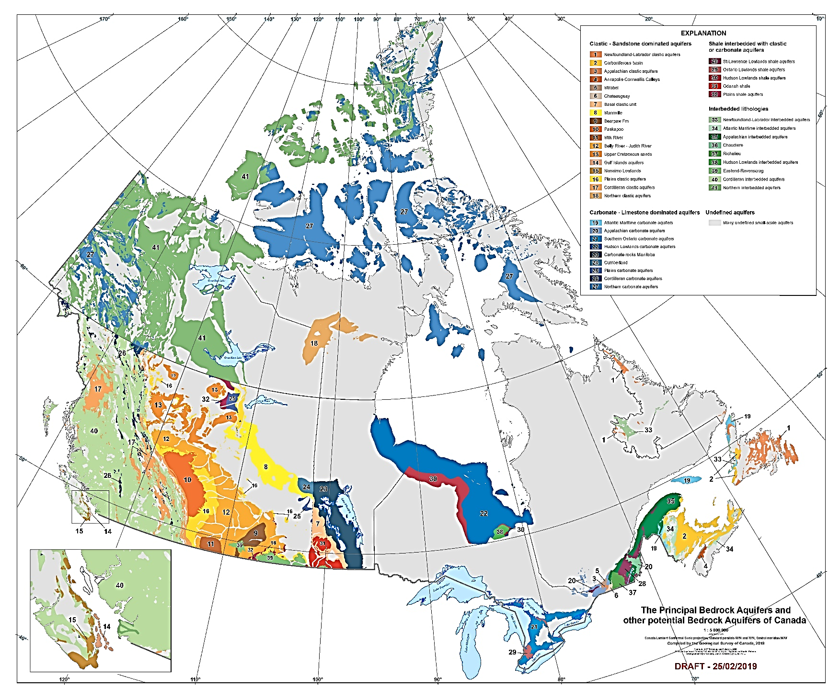
Preliminary map of the Principal Bedrock Aquifers of Canada
(Rivera et al., 2018)

Slide 20
Summary and Next Steps
A preliminary national-scale map of the principal bedrock aquifers of Canada has been initiated.
This digital, interactive national-scale aquifer map is designed to tacking several national-scale water-related issues
Input from provincial partners is needed to complete, correct, modify and agree with the national map.
This first integrated map of the principal aquifers of Canada will be available in the Groundwater Information Network.

Slide 21
GROUNDWATER INFORMATION NETWORK (GIN) Boyan Brodaric Geological Survey of Canada

Slide 22
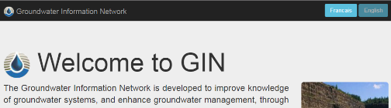
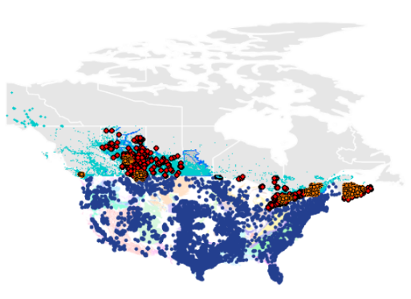
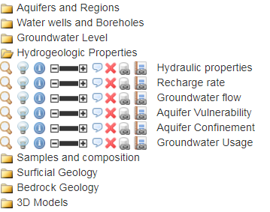
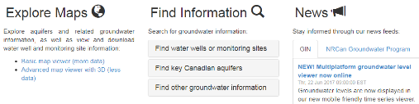
Groundwater Information Network (GIN)
2012 - present
National (distributed / hosted)
YK BC AB SK MB ON QC NS NL
International
USA, EU, AU
Data Layers
Usage
Usage Statistics FY 2018-19
users: 14,442
return visitors: 65%
data downloads: 2264
water well views 10450

Slide 23
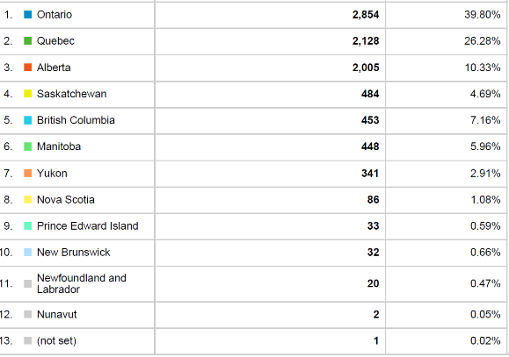
More Stats
What’s coming?
Data
Geophysical Boreholes (GSC)
GSC projects (various)
Data standard (GIN, GWML2)
New GIN portal
New user interface
New data synch
- real-time data
New data delivery (Google-friendly)
- Linked Data (CAN-US)
New tools:
- 3D well viewer
- Complex borehole viewer
- Groundwater dashboard
- Water level calculator
(well, aquifer; past, future)
- other?
Introducing
GIN Partner Contact: Girard, Étienne etienne.girard@canada.ca

Slide 24
OVERVIEW
Participants Role call (5-10 min)
Opening remarks (5 min) – Daniel Lebel
Groundwater Geoscience Program (5 min) - Yves Michaud
Archetypal Aquifer Project (5 min) - Hazen Russell
Mapping the Principal Bedrock Aquifers of Canada (5 min) - Alfonso Rivera
Groundwater Information Network (5 min) - Boyan Brodaric
Logistics for future meetings (5 min)
Content
Format
Comments / suggestions (15 min)

Slide 25
THANK YOU
/
MERCI!

